Slide 1
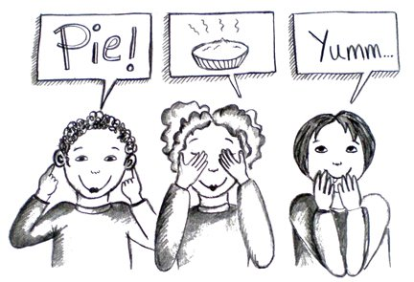
Notes:
Introduction: Hi everyone! How many of you know what your ‘Best’ Learning Modality is? Modality means: “the way information is processed by you in order to remember” ASK A FEW STUDENTS WHAT THEIR ‘BEST LEARNING MODALITY IS.” if there are no volunteers, ask a few students “WHAT’S YOUR FAVORITE ACADEMIC SUBJECT” Discuss why this subject is their favorite, how do they succeed in this subject. MAKE AN INFERENCE OF WHAT MODALITY IS BEING USED.
INTRODUCE THE LEARNING STYLE GAMES TO FIND OUT WHAT MODALITIES WORK BEST! “LETS PLAY A GAME TO FIND OUT WHAT KIND OF LEARNER YOU MIGHT BE!”

Slide 2
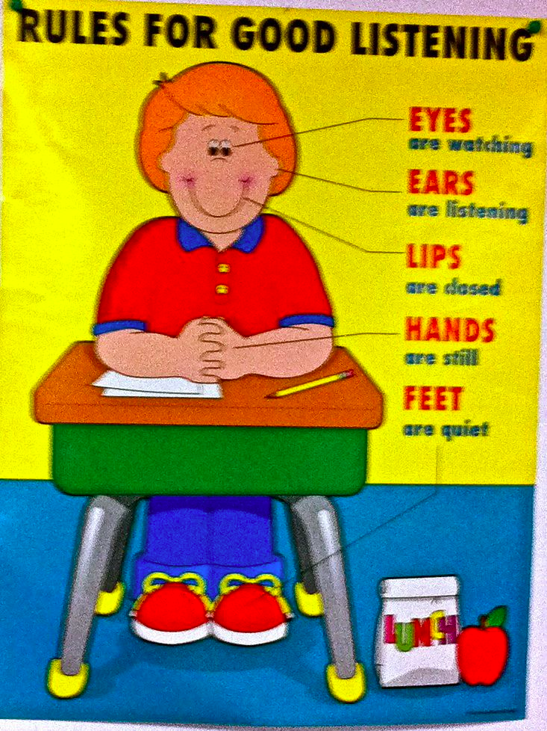
Notes:
IN THE FIRST PART OF OUR GAME: “I’m going to give you a list of things to get at the grocery store. I’m only going to say the list once then I will ask you to write the list down on a piece of paper from memory.”
Plastic wrap
Corn
Conditioner
Lentils
Squash
Plums
Butter
Rice
Vinegar
Tea

Slide 3
Notes:
FOR THE SECOND PART OF OUR GAME: I’m going to show you a slide with items on them. I will give you 15 seconds to look at the items and then I’m going to ask you to pick up your pencils and write what you saw. Please don’t pick up your pencils until I tell you to. WAIT 5 SECONDS AFTER THE SLIDE TO GIVE THE DIRECTIONS.

Slide 4
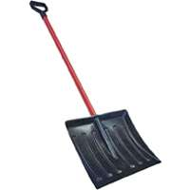
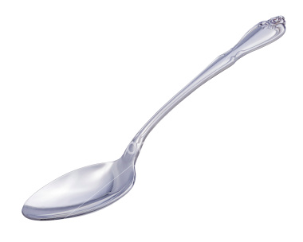
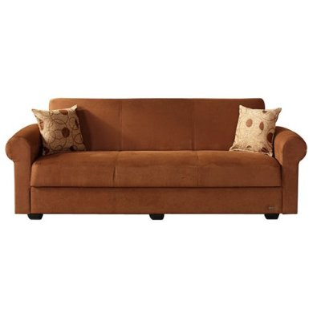
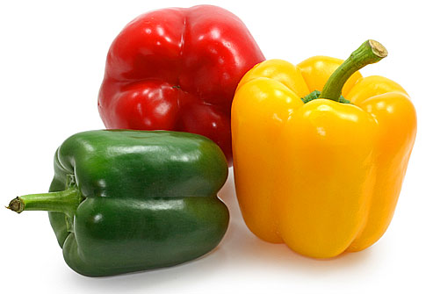
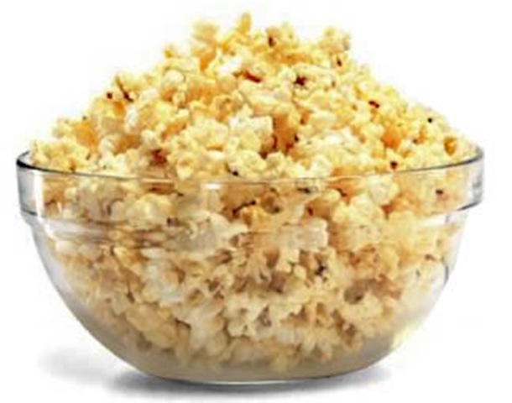
Notes:
15 SECONDS

Slide 5
Notes:
IN THE THIRD PART OF THE TEST….I’m going to give you a list of foods that are good for your brain! For this part of the test. I need everyone to stand up and give yourself some room to ‘DO’ what I’m going to ask you to do. Remember! I’m going to ask you to list the foods after I give you the list of foods that are good for your brain.
The list of foods have gestures attached to them.
Blueberries
Spinach
Nuts
Broccoli
Fish
Tomatoes
Bananas
Yoghurt
Olive oil
Whole Grain

Slide 6
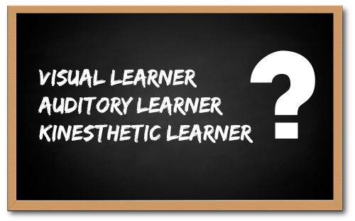
http://www.berghuis.co.nz/abiator/lsi/lsiframe.html
Notes:
How may of you think you are visual (raise hands), auditory, and kinesthics
Okay…Lets find out for sure.
20 minutes to take the online assessment…
Identify learning style groups and request that they form a group

Slide 7
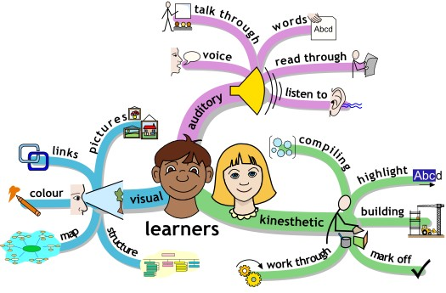
Notes:
ACTIVITY
Each group is asked to identify a subject that as a group they struggle to remember the material: Why

Slide 8
Notes:
Allow this group to talk about what subjects are more difficult/easier and why…
Optimal approach: writing, geometry
ANYTHING DONE QUICKLY WILL NOT BE STORED INTO LONG TERM MEMORY….YOU WILL NOT HAVE THE INFORMATION IN MEMORY FOR MID-TERM OR FINAL EXAMS

Slide 9
Learning Style: Dominant Visual
Notes:
Allow this group to talk about what subjects are more difficult/easier…Why
Optimal approach: geometry, History
ANYTHING DONE QUICKLY WILL NOT BE STORED INTO LONG TERM MEMORY….YOU WILL NOT HAVE THE INFORMATION IN MEMORY FOR MID-TERM OR FINAL EXAMS

Slide 10
Notes:
Allow this group to talk about what subjects are more difficult/easier…Why
Optimal approach: writing, history
ANYTHING DONE QUICKLY WILL NOT BE STORED INTO LONG TERM MEMORY….YOU WILL NOT HAVE THE INFORMATION IN MEMORY FOR MID-TERM OR FINAL EXAMS

Slide 11
Good Study Habits!
Testing enhances memory (Roediger&Karpicke 2006) FEEDBACK!
Worst time to study: right afterschool
Lighting: low light is okay
Prioritize study sessions
MUSIC without words: Baroque is the best!
60 Beats per minute = Resting heart rate = long term memory brain waves
Best color for studying is RED…= to long term memory
Concept mapping (stensvold & Wilson 1990)
Draw a picture…brain remembers pictures best…
Study the vocabulary
Answer the embedded questions in the text book (Callender and MDaniel 2007)
Notes:
Closing: Discuss study habits that work for different learning modalities
WATCH YOUTUBE VIDEO: http://www.youtube.com/watch?v=fQYW6vYSGXs&feature=related

