Slide 1
The Role of Learning Beliefs on the Acquisition of Self-regulated Learning and Academic Achievement of Students Transitioning to High School
Silvia Moore
George Mason University
September 4, 2014

Slide 2
Purpose of Study
The purpose of this experimental study is to examine the primacy of attribution beliefs in initiating the self-regulatory component of goal setting to promote motivation for academic engagement and academic achievement (Graham & Weiner, 2012; Ford, 1992). It is conjectured that stressful life experiences (such as transitioning from middle school to high school) could be the source of negative attributional styles that lead some students to a downward academic trajectory.
An intervention focused on making meaning of past experiences to revise dysfunctional attributional styles, a significant risk factor for the development of maladaptive behavior, may have long-range effect for high school students’ academic engagement and academic achievement.

Slide 3
Significance of Study
The reasons learners give for academic successes or failures (causal attributions) influence their future expectations, motivation, and emotions (Weiner, 2008). When learners recognize, appreciate, and understand their academic ability as unstable they are able to engage in appropriate actions (e.g., goal setting) and engender a greater sense of control over academic behavior and more motivation to achieve (McCombs & Marzon, 1990; Stewart et al., 2011).

Slide 4
How Study Extends ‘Field’ Knowledge
To our knowledge, no research has attempted to investigate the effect on academic engagement and achievement by unifying the self-regulatory process of goal setting and attributional retraining at the transition period between of the high school level.

Slide 5
Key Terms
The variables studied include attribution styles, goal setting, academic engagement and academic achievement. Homework completion and homework quality are used to measure academic engagement, while exam grades and GPA are used to measure academic achievement.

Slide 6
Literature Review Negative beliefs [constructed from experiences] trigger negative perceptions and emotions resulting in both nonfunctional thinking and behaviors (MCcombs & Marzano, 1990).
The period between middle to late adolescence is marked by an increase in stressful life events due in part by the biological and psychological changes, as well as by the social forces encountered by 15 to 18 year olds (Berk, 2013; Rodriguez-Naranjo & Caño, 2011).
Some motivation theorists suggest that the core beliefs held by students shape their responses to challenges (Blackwell, L. Trzesniewski, K., & Dweck, C., 2007). For example, some students may see challenges as setbacks to be overcome, while others may not overcome the difficulties without the help of others.
Evidence for the positive effects of goal setting for academic engagement is offered by Andrew Martin (2012) who reports that persistent academic engagement of 7,637 high school students from 14 Australian schools was positively affected by the adaptive behavior resulting from goal setting.

Slide 7
Research Questions
In the present study we focus on transitioning high school students and how an attribution-revision intervention will affect self-regulation (goal setting), academic engagement and academic achievement. We are also interested in determining whether attributional retraining changes the types of goals high school students devise, and whether these goals lead to greater academic engagement and improved GPA.

Slide 8
Participants
Participants consist of a convenience sample of 60 ninth-grade high school students enrolled in Human Development course at a private school in a suburban area of a major east coast city in the United States. The school has a population of approximately 508 students, predominantly white, from the upper socioeconomic status.
Students. Data will be reported from 60 adolescents (ages 14-15); all students will be fluent English speakers. Students with Learning Disabilities (LD) in the 9th grade make up 32% of that grade level’s population (17) and will be included in the population.

Slide 9
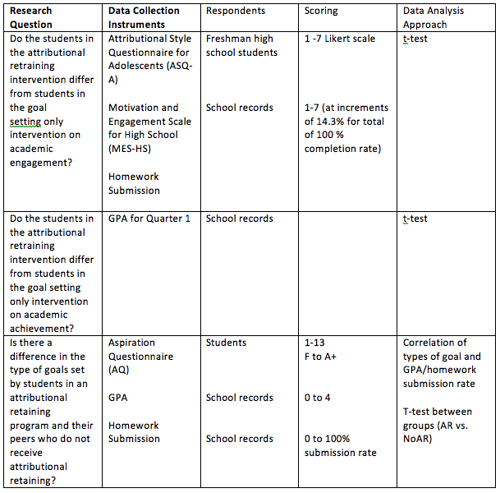
Research Questions/Data Collection

Slide 10
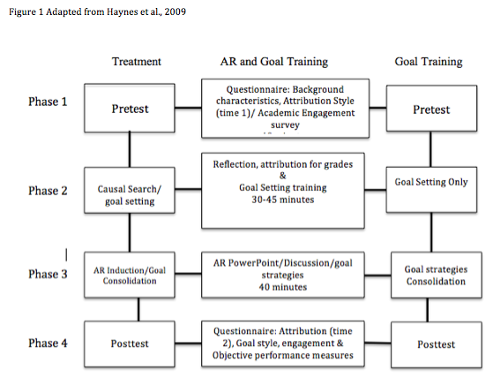
Quasi-Experimental Research Intervention Study Procedures

Slide 11
Design of Study
This study can be considered a 2 (Attribution retraining with goal setting and goal setting with no attribution retraining) X 2 (average students and low average students) between-subjects factorial design, because there are two independent variables. The intervention has two levels, AR and NoAR. The student condition has two levels: average (2.5 to 3.0 GPA) and low average (< 2.4 GPA). The dependent measures are goal setting, academic engagement (homework submission and quality) and academic achievement GPA.

Slide 12
References
Akos, P., & Galassi, J. P. (2004). Gender and race as variables in psychosocial adjustment to middle and high school. The Journal of Educational Research, 98(2), 102-108.
Appleton, J., Christenson, S., & furlong, M., (2008). Student engagement with school: Critical conceptual and methodological issues of the construct. Psychology in the Schools, 45, 369-386.
Bandura, A., (1977). Self-efficacy: Toward a unifying theory of behavioral change. Psychological Review. 84, 191-215.
Bandura, A., (1977). Self-efficacy: Toward a unifying theory of behavioral change. Psychological Review. 84, 191-215.
Benner, A. (2011). The transition to high school: Current knowledge, future direction. Educational Psychology Review, 23, 299-328. DOI 10.1007/s10548-011-09152-0.
Benner, A., & Graham, S. (2009). The transition to high school as a developmental process among multiethnic urban youth. Child Development, 80, 356-376.
Berkley S., Mastropieri, M., & Scruggs, T. (2011). Reading Comprehension Strategy Instruction and attribution retraining for secondary students with learning and other mild disabilities. Journal of Learning Disabilities, 44(1), 18-32.
Berk, L. (2013). Exploring lifespan development. Pearson Higher Education. Cranbury, NJ.
Blackwell, L. Trzesniewski, K., & Dweck, C., (2007). Implicit theories of intelligence predict achievement across an adolescent transition: A longitudinal study and an intervention. Child Development, 78, 246-263.
Dweck, C. S., & Leggett, E. L. (1988). A social-cognitive approach to motivation and personality. Psychological Review, 95, 256 – 273.
Ford, M. (1992). Motivating Humans: How to motivate people: principals and applications (pp. 201-243). Sage Publications Inc., Newbury Park, CA.
Fredericks, J., Phyllis, C., & Paris, (2004). School engagement: Potential of the concept state of evidence. Review of Educational Research, 74, 59-109.
Graham, S., & Weiner. B., (2012). Motivation: Past, present and future. APA Educational Psychology Handbook. DOI: 10.1037/13273.013.
Harris, L. (2011). Secondary teachers’ conceptions of student engagement: Engagement in learning or in schooling? Teaching and Teacher Education, 27, 376-386. DOI: 10.1016/j.tate.2010.09.006
Hall, N. C., Perry, R. P., Goetz, T., Ruthig, J. C., Stupnisky, R. H., & Newall, N. E. (2007). Attributional retraining and elaborative learning: Improving academic development through writing-based interventions. Learning and Individual Differences, 17, 280-290.
Haynes, T., Ruthig, J., Perry, R., Stupnisky, R., & Hall, N. (2006). Reducing the academic risks of over-optimism: The longitudinal effects of attributional retraining on cognition and achievement. Research in Higher Education. 47(7), 755-781. DOI: 10.1007/s11162-006-9014-7.
Haynes-Stewart, T., Clifton, R., Daniels, L. Perry, R., Chipperfield, J., & Ruthig (2011). Attributional retraining: Reducing the likelihood of failure. Social Psychology Education, 14, 75-92.

Slide 13
References continued
Helme, S. & Clarke, D. (2001). Identifying cognitive engagement in the mathematics classroom. Mathematics Education Research Journal, 13(2), 133-153.
Hudley, C., Britsch, B., Wakefield, W., Smith, T., Domarat, M., & Cho, S. (1998). An attribution retraining program to reduce aggression in elementary school students. Psychology in the Schools, 35(3), 271-283.
Letrello, T. M., & Miles, D. D. (2003). The transition from middle school to high school:
Students with and without learning disabilities share their perceptions. The Clearing
House, 76(4), 212-214.
Locke, E. A., & Bryan, J. F. (1968.) Grade goals as determinants of academic achievement. Journal of General Psychology, 79, 217-228.
Martin, A. J. (2006). Personal bests (PBs): A proposed multidimensional model and empirical analysis. British Journal of Educational Psychology, 76, 803–825.
Martin, A. J. (2007a). Examining a multidimensional model of student motivation and engagement using a construct validation approach. British Journal of Educational Psychology, 77, 413–440.
Martin, A. J. (2008b). The Motivation and Engagement Scale. Sydney: Lifelong Achievement Group (www.lifelongachievement.com).
Martin, A., (2011). Courage in the classroom: Exploring a new framework predicting academic performance and engagement. School Psychology Quarterly, 26, 145-160.
Martin, A., (2012). The role of personal best (PB) goals in the achievement and behavioral engagement of students with ADHD and students without ADHD. Contemporary Educational Psychology, 37, 91-105.
McClure, J., Walkey, F., Meyer, L., & Weir, K. (2013). Low expectations equal no expectations: Aspirations, motivation and achievement in secondary school. Contemporary Educational Psychology, 38, 306-315.
McCombs, B., & Marzano, R. (1990). Putting the self in self-regulated learning: The self as agent in integrating will and skill. Educational Psychologist, 25(1), 51-69.
Mega, C., Ronconi, L., & De Beni, R. (2014). What makes a good student? How emotions, self-regulated learning, and motivation contribute to academic achievement. Journal of Educational Psychology, 106(1), 121-131. DOI: 10.1037/a0033546.
Nield, R. C., Stoner-Eby, S., & Furstenberg, F. (2008). Connecting entrance and departure: The transition to ninth grade and high school dropout. Education and Unban Society, 40, 543-569.

Slide 14
References continued
Perry, R. & Penner, K. (1990). Enhancing academic achievement in college students through attributional retraining and instruction. Journal of Educational Psychology, 82(2), 262-271.
Perry, R., Stupnisky, R., Hall, N., Chipperfield, J, & Weiner, B. (2010). Bad starts and better finishes: attributional retraining and initial performance in competitive achievement settings. Journal of Social and Clinical Psychology, 29 (6), 668-700.
Pintrich, P. (2000). An achievement goal theory perspective on issues in motivation terminology, theory, and research. Contemporary Educational Psychology, 25, 92-104. DOI: 10.1006/ceps.1999.1017.
Reyes, O., Gillock, K.L. Kobus, K., & Sanchex, B. (2000). A longitudinal examination of the transition into senior high school for adolescents from urban, low-income status, and predominantly minority backgrounds. American Journal of Community Psychology, 23, 519-536.
Roderick, M. (2003). What’s happening to the boys? Early high school experiences and school outcomes among African American male adolescents in Chicago. Urban Education, 38,538-607.
Rodriguez-Naranjo, C., & Caño, A. (2010). Development and Validation of an attributional style questionnaire for adolescents. Psychological Assessment, 22(4), 837-851.
Schunk, D. (1994). Self-regulation of learning and performance issues and educational applications: Self-regulation of self-efficacy and attributions in academic settings (pp.75-96). Routledge: Taylor & Francis Group. Boca Raton, FL.
Spinath, B. & Steinmayr, R. (2012). The roles of competence beliefs and goal orientations for change in intrinsic motivation. Journal of Educational Psychology. DOI: 10.1037/a0028115.
Steinberg, L., (1996). Beyond the classroom: Why school reform has failed and what parents need to do. Simon & Schuster, New York, New York.
Stupnisky, R., Stewart, T., Daniels, L. & Perry, R. (2011). When do students ask why? Examining the precursors and outcomes of causal search among first-year college students. Contemporary Educational Psychology. 36, 201-211. DOI: 10.1016/j.cedpsych.2010.06.004.

Slide 15
References continued
Swinton, A., Kurtz-Costes, B., Rowley, S., & Okeke-Adeyanju, N. (2011). A longitudinal examination of African American adolescents’ attribution about achievement outcomes. Child Development, 32(5), 1486-1500.
Wallis, J., & Barrett, P., (1998). Adolescent adjustment and the transition to high school. Journal of Child and Family Studies. 7(1), 43-58. DOI: 1062-1024/98/0300-0043.
Weiner, B. (2008). Reflections on the history of attribution theory and research: People, personalities, publications, and problems. Social Psychology. 39(3), 151-156. DOI: 10.1027/1864-9335.39.3.151.
Weiner, B. (2010). The Development of an attribution-based theory of motivation: A history of ideas. Educational Psychologist, 45(1), 28-36. DOI: 10.1080/00461520903433596.
Wingfield, A., Eccles, J., Mac Iver, D., Reuman, D., & Midgley, C., (1991). Transitions during early adolescence: Changes in children’s domain-specific self-perceptions and general self-esteem across the transition to junior high school. Developmental Psychology, 24(4), 552-565. DOI: 0012-1649/91.
Wolters, C., Fan, W., & Daugherty, S. (2013). Examining achievement goals and causal attributions together as predictors of academic functioning. The Journal of Experimental Education, 8(3), 295-321. DOI: 10.1080.00220973.2012.700498.
Ziegler, A. & Stoeger, H. (2004). Evaluation of an attributional retraining (modeling technique) to reduce gender differences in chemistry instruction. High Ability Studies, 15(1) 63-83.
Zimmerman, B. (1989b). Self-regulated learning and academic achievement: Models of self-regulated learning and academic achievement. (pp. 1-25). Springer-Verlag New York Inc., New York, New York.
Zimmerman, B. (2008). Investigating self-regulation and motivation: Historical background, methodological developments, and future prospects. American Educational Research Journal, 45(1), 166-183.
Zimmerman, B. & DiBenedetto, M. (2010). Differences in self-regulatory processes among students studying science: A microanalytic investigation. The International Journal of Educational and Psychological Assessment, 5, 2-24.

